Slide 1

ELIXIR DOCUMENTATION
How to create students guide

Slide 2
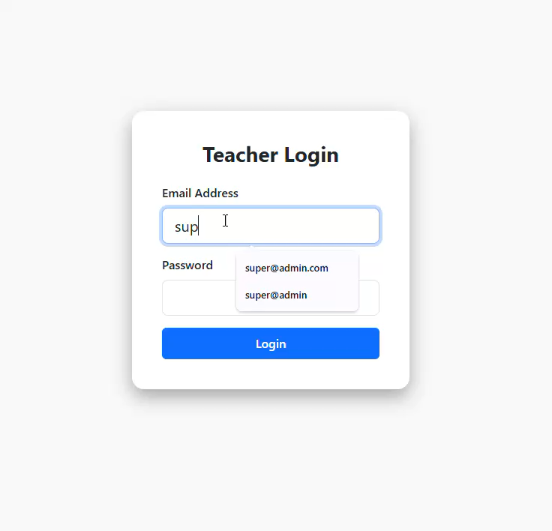
Login http://elixir.test for local machine
Email address: super@admin.com password: password

Slide 3
Login http://your_ip_address for remote machine

Slide 4
Steps on how to create a student

Slide 5
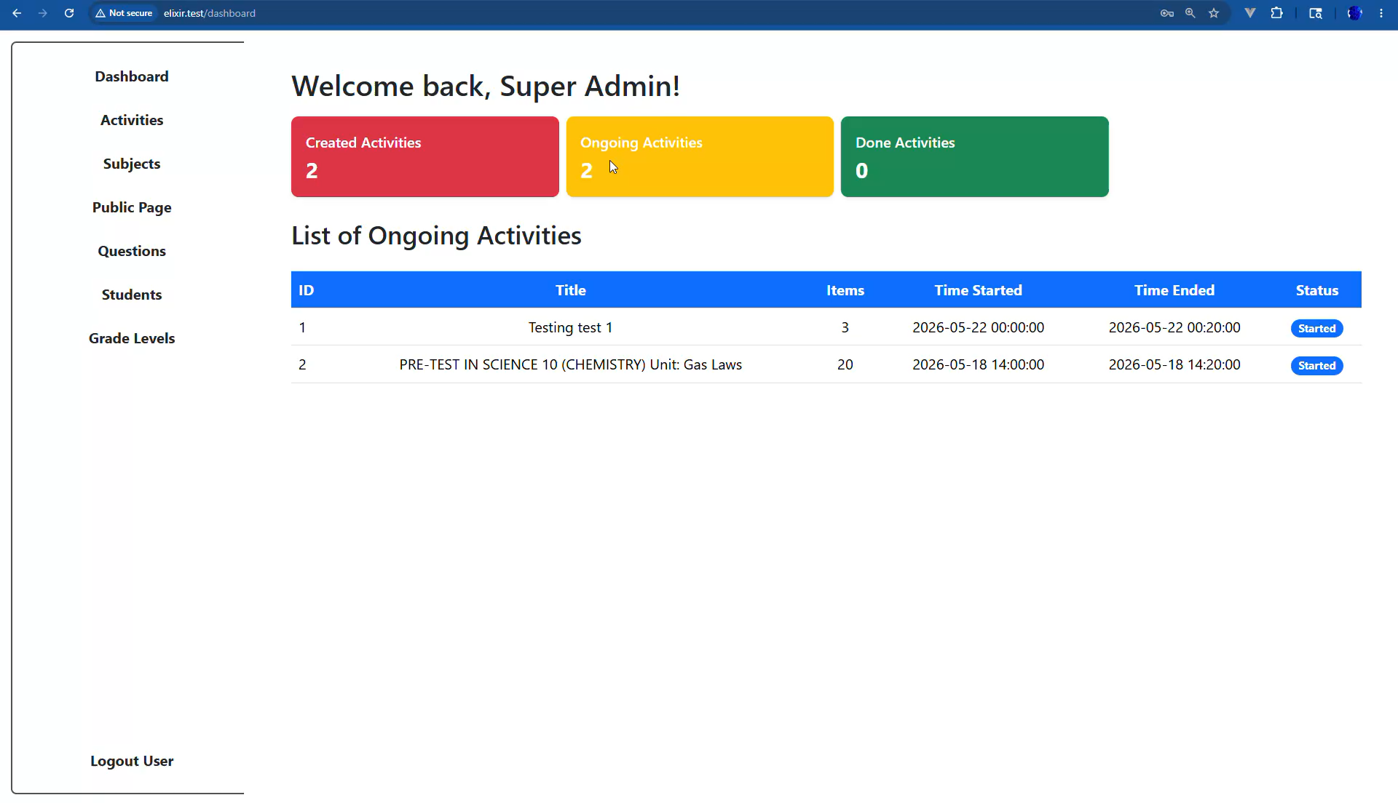
1. Create a student
Note: creating a student will automatically creates a password as default 123456.
This is to use as credentials to enter in an activity which is requiring
student ID number and default password 123456

Slide 6
End

